Slide 1
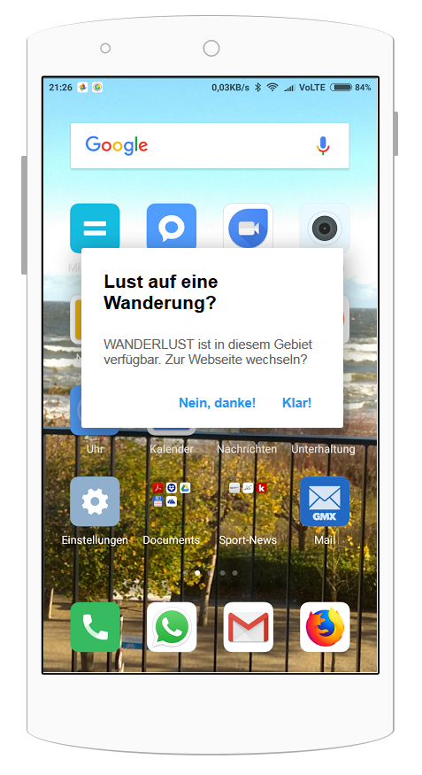
UI – Screens (1)
Popup triggered by BLE-Beacon near to start point of hiking track
User has the possibility to switch to the WANDERLUST website or ignore the service

Slide 2
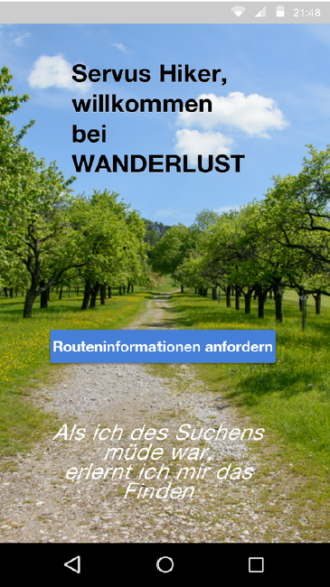
UI – Screens (2)
Landing page of WANDERLUST
User can request track information

Slide 3
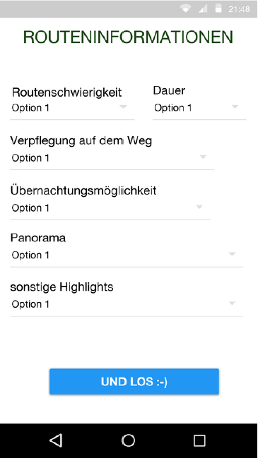
UI – Screens (3)
User can enter several filter options to find the perfect track

Slide 4
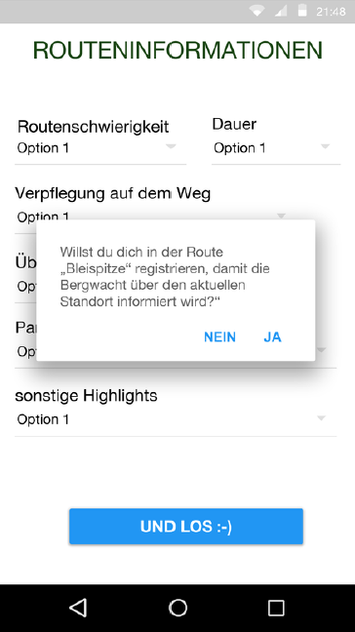
UI – Screens (4)
After the decision for a specific track WANDERLUST offers the possibility to register with the mountain rescue service

Slide 5
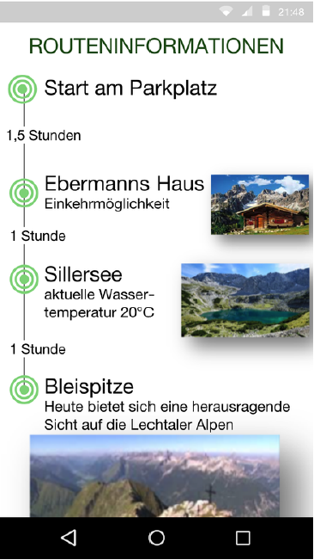
UI – Screens (5)
WANDERLUST provides the user an overview of the important waypoints on the selected track
Including pictures and short descriptions for the waypoints
Average times between the waypoints are displayed

Slide 6
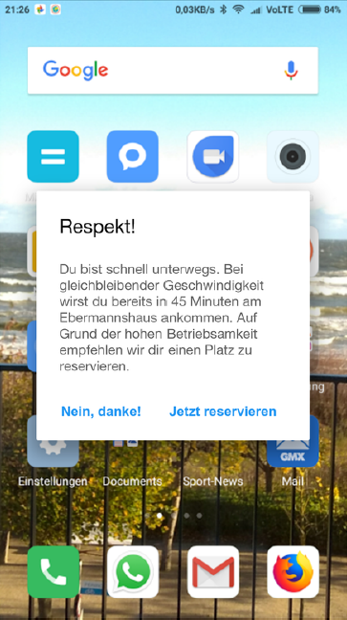
UI – Screens (6)
Informational popups
about estimated time to the next waypoint
the possibility to make a seat reservation at the next restaurant

Slide 7
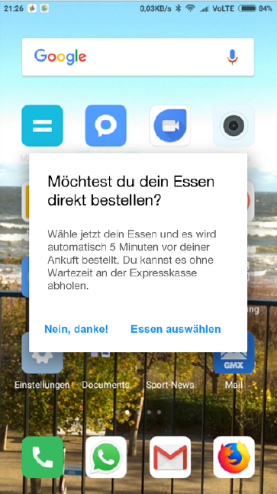
UI – Screens (7)
If the user uses the possibility to reserve a seat it is also possible to preselect a meal and pick up without waiting time at an express line

Slide 8
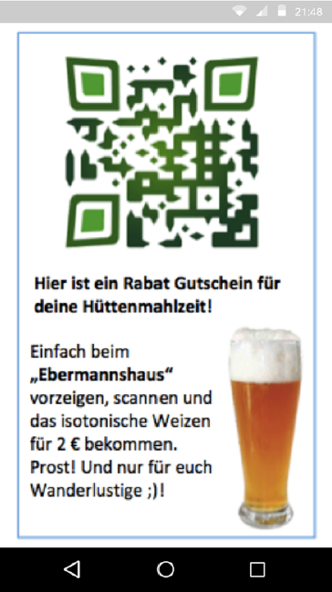
UI – Screens (8)
Special offers could be provided via QR-Code

Slide 9
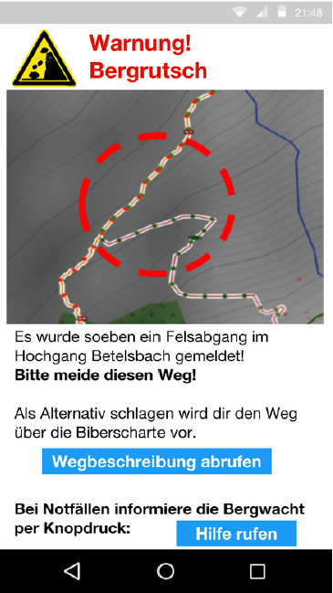
UI – Screens (9)
If necessary security information are pushed on the users device
Of course alternative tracks and the possibility for a one-click emergency call are provided

Slide 10
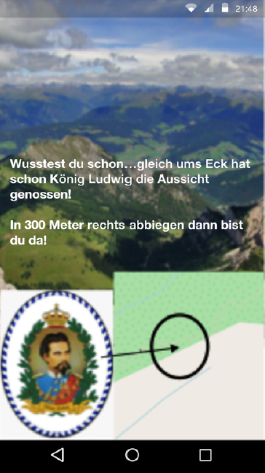
UI – Screens (10)
Information about interesting spots around the user are pushed through beacons
Also including historical and funny facts

Slide 11
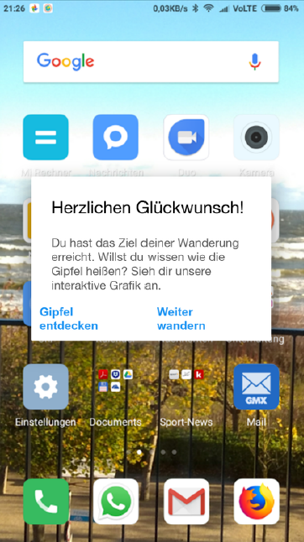
UI – Screens (11)
Congratulation screen after reaching the summit
Offers an interactive map of the surrounding mountains

Slide 12
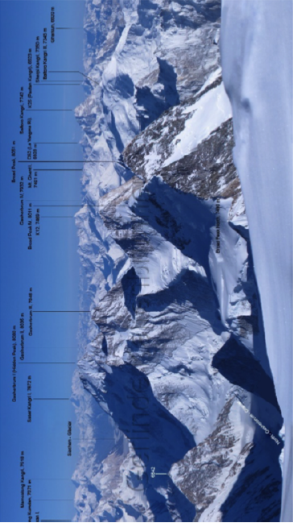
UI – Screens (12)
Interactive map of surrounding mountains
Maybe in a later stage including AR

Slide 13
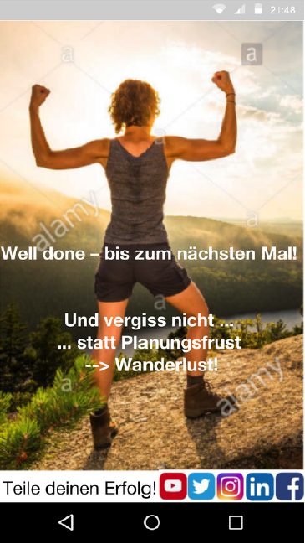
UI – Screens (13)
Success screen
Engage the user to share the reached achievements on social media
Remind the user to use WANDERLUST again

